Slide 1



CS550: Machine Learning
(2024-25M) Course Project
CAUESC: A CAUSAL AWARE MODEL FOR EMOTIONAL SUPPORT CONVERSATION
Team: Strikers
TA assigned: Mohit Kumar
Instructor: Dr. Rajesh Kumar Mundotiya

Slide 2


PROBLEM STATEMENT
Emotional Support Conversation Models are developed to reduce emotional distress and comfort individuals by offering empathetic responses. With the increasing reliance on AI-driven chatbots for mental health and support services, the ability of these models to understand and respond to complex human emotions has become essential.
Emotional Support Conversation Models need various parameters for optimizing the needed response to console the support seeker. For users seeking genuine emotional support, this can lead to frustration and disengagement, undermining the purpose of such systems.

Slide 3
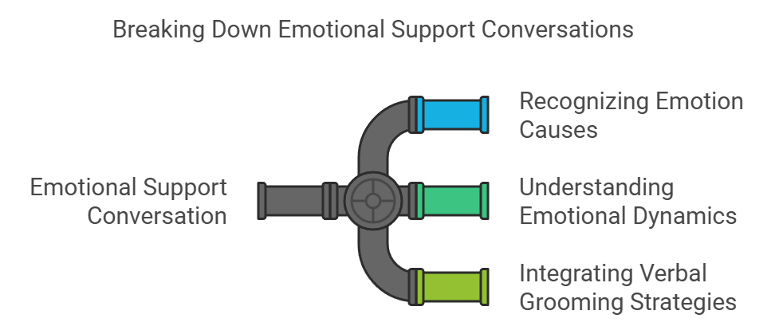
Previous Work and Novelty
Limitations of Existing Approaches for ESConv Model
Many current dialogue systems face significant challenges:
Inability to Identify Root Causes: Existing systems often respond based only on the immediate context, ignoring the underlying reasons for emotional distress.
Static Interaction: These models fail to adapt responses dynamically based on the emotional exchange between the seeker and the supporter.
Lack of Empathy: Most models generate generic, surface-level responses without true emotional understanding.
This project aims to develop a cutting-edge machine learning model that addresses these limitations by incorporating causal awareness, allowing for deeper empathy and more effective emotional support

Slide 4
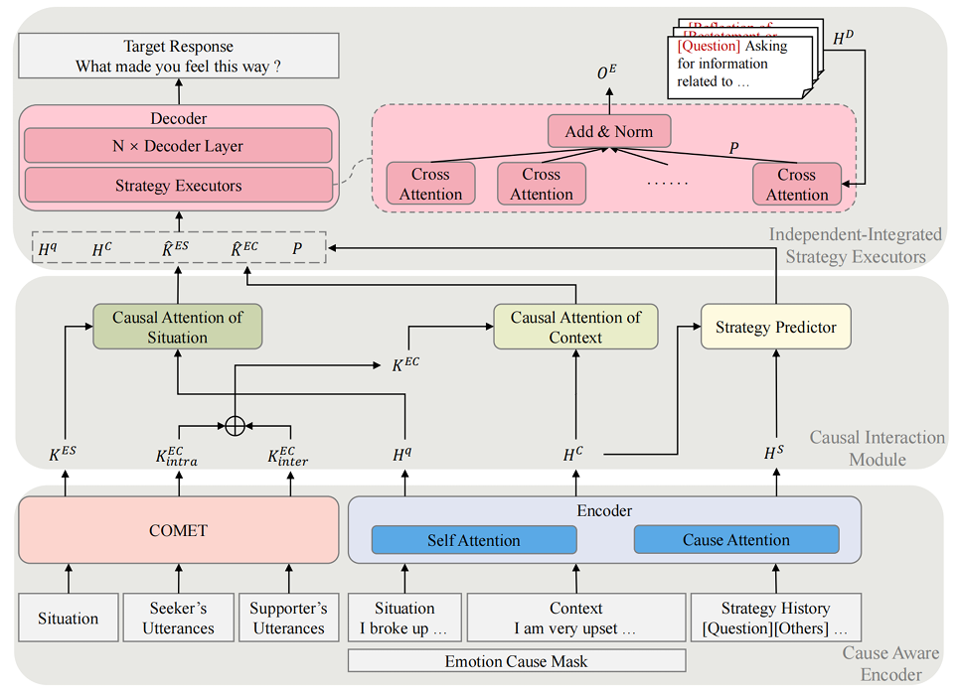
Methodology
To address the limitations of existing Emotional Support Conversation (ESC) models, we based our project on the research presented in CauESC: A Causal Aware Model for Emotional Support Conversation.
This model introduces a novel approach to generating empathetic responses as:
Unlike traditional models, CauESC identifies the root causes behind a user's emotional distress, enhancing targeted, supportive responses.
The model leverages the COMET(Commonsense Transformers) framework, to infer emotional effects using if-then reasoning.
CauESC uses an independent-integrated strategy executor, to adopt multiple support strategies in a single response, tailored to the conversation's emotional context.

Slide 5
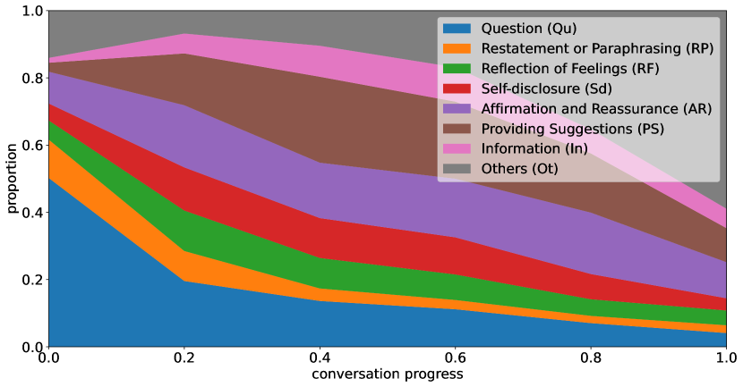



DATASET PREPARATION
We used the ESConv dataset, a widely recognized dataset for emotional support conversations. This dataset includes dialogues where supporters respond empathetically to seekers in distress.
Data Annotation:
Emotion Causes: Each dialogue was manually reviewed to label the utterances that triggered emotional responses in seekers.
Support Strategies: Annotated the dialogues to identify and categorize different supportive strategies used by the supporters, such as Reflection of Feelings, Providing Suggestions, and Self-disclosure.
Emotional Effects: Marked responses that demonstrated changes in the seeker's emotional state as influenced by the support provided.
Data Cleaning: Ensured the dataset was free of sensitive, inappropriate, or irrelevant content to maintain ethical standards and model quality.
Strategy distributions of ESConv Dataset

Slide 6
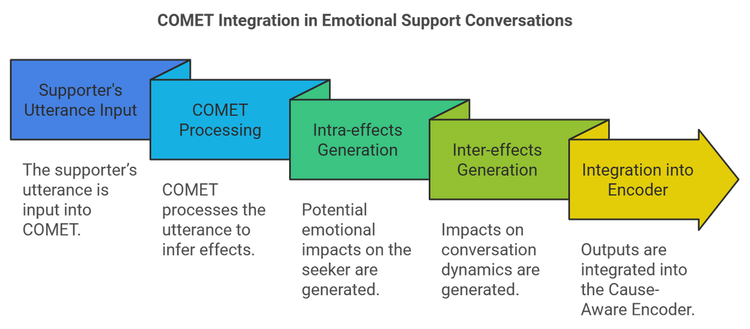
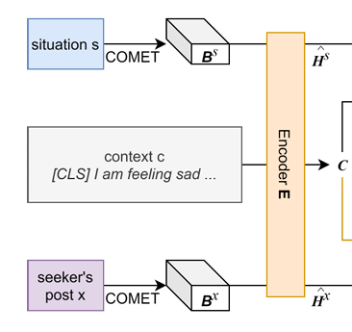
COMET Usage in CauESC
01. Input Utterance
03. Adapting to Inputs
To effectively capture the nuanced relationship between a user's emotional state and the support offered, COMET (Commonsense Transformer) is integrated into our model for causal reasoning.
Instead of the typical context ‘C’ provided to the model, we use supporter’s utterances as the input events for COMET.
This substitution allows the model to generate insights about how the supporter's input might affect the emotional state of the seeker.
02. COMET
04. Implementation
COMET, built upon the ATOMIC knowledge base, generates commonsense inferences about social interactions and events.
The supporter’s utterance is fed into COMET, which returns potential intra-effects(emotional impact on the user) and inter-effects(impact on the conversation dynamics).
Speaker’s utterance

Slide 7
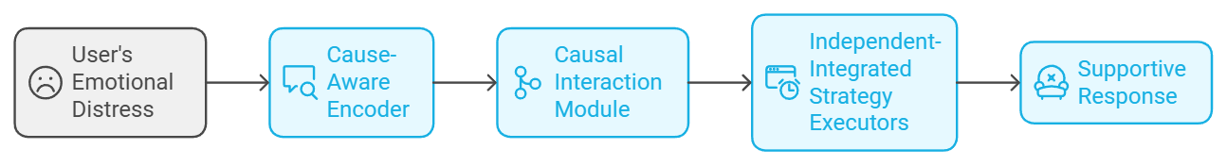
OVERVIEW OF CAUESC MODEL
The implementation of the CauESC model is built on a multi-component architecture designed for effective emotional support conversation.
Recognizes and encodes emotional distress causes using cause attention mechanisms
Executes and integrates the needed support strategies for coherent responses
Integrates commonsense knowledge(from COMET) to reason about emotional effects of utterances on speaker(Intra) and interaction(Inter)

Slide 8
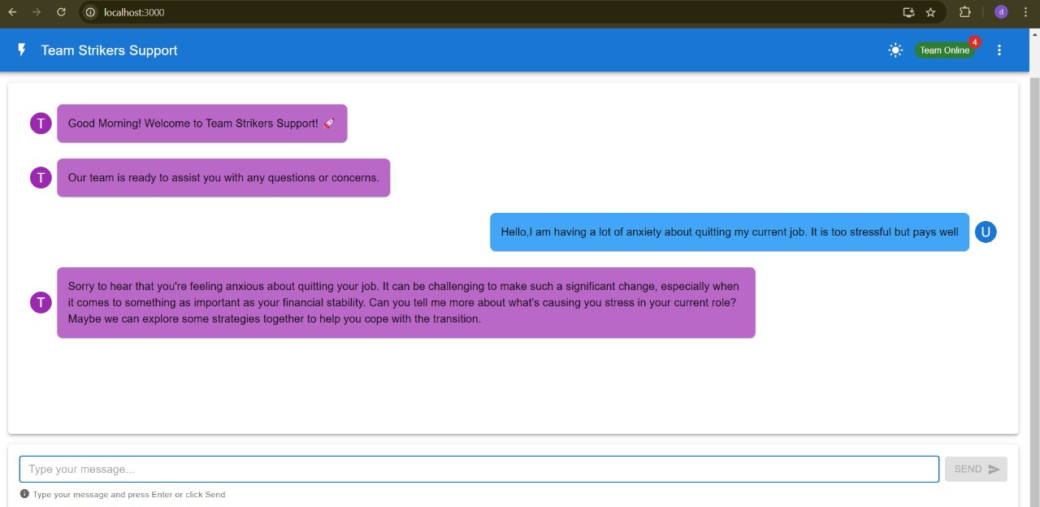
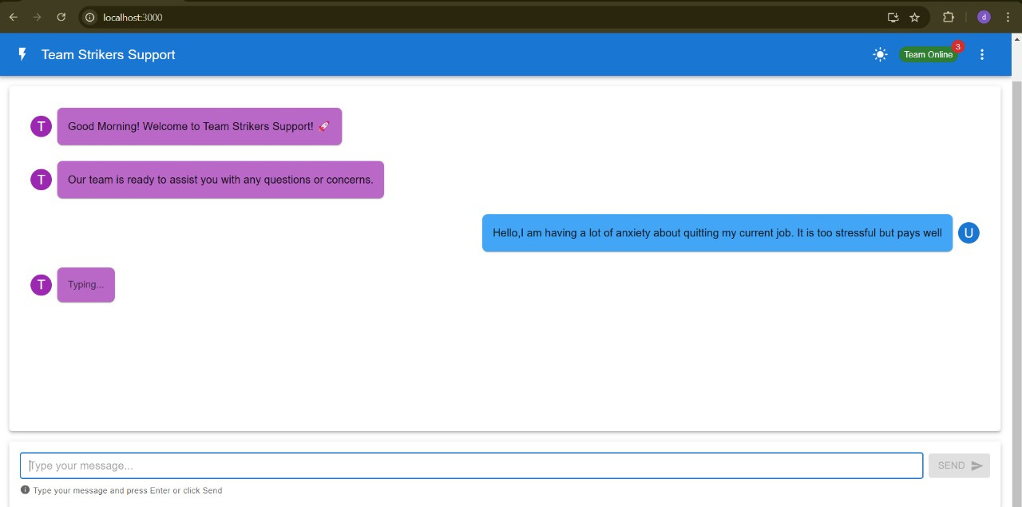
CHAT SNIPPETS

Slide 9
INDIVIDUAL CONTRIBUTIONS
Akshat Kumar(12240080)
Developed the code and theory of the Code
Aditya Prakash(12240040)
Developed the code and theory of the project.
Anand Vardhan(12240140)
Formulated the project report and theory of the project.
Shashank Pant(12241700)
Theoritical buildup for code and UI of the chat system
Github Link: CauESC: Emotional Support Conversation Model

